Slide 1
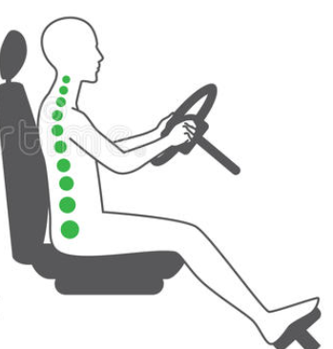
PREVENTING FATIGUE AND IMPROVING CONTROL
CORRECT SEATING POSITION - Vehicle Fit
7
6
5
3
4
1
2
On entering the vehicle ensure parking brake is applied. (This could be a switch, button, hand lever or foot operated).
1. Seat position with upper and lower back.
2. With left foot on clutch (fully depressed) or if automatic on footrest, left thigh should be as close to horizontal as possible.
3. Hands to be placed at 9 and 3 (using a clock face). This enables “Instant” steering, improved air bag deployment and better access to hand controls.
4. Check bends in elbow. A slight bend is required to share the arm weight between wrist and shoulder. This lessens the effect of fatigue and increases blood flow to the brain.
5. Distance between chest and steering wheel ideally should be around 25 cm to allow for air bag deployment.
6. Sight (High aim steering) alignment, ideally 8cm above steering wheel.
7. Head restraint effectiveness, a line from the eye through center of ear to middle of headrest.
Once the above adjustments are completed, then rear-view mirror settings (including blind spot) can be made.

