Slide 1
SADD
Students Against Dangerous Driving

Slide 2
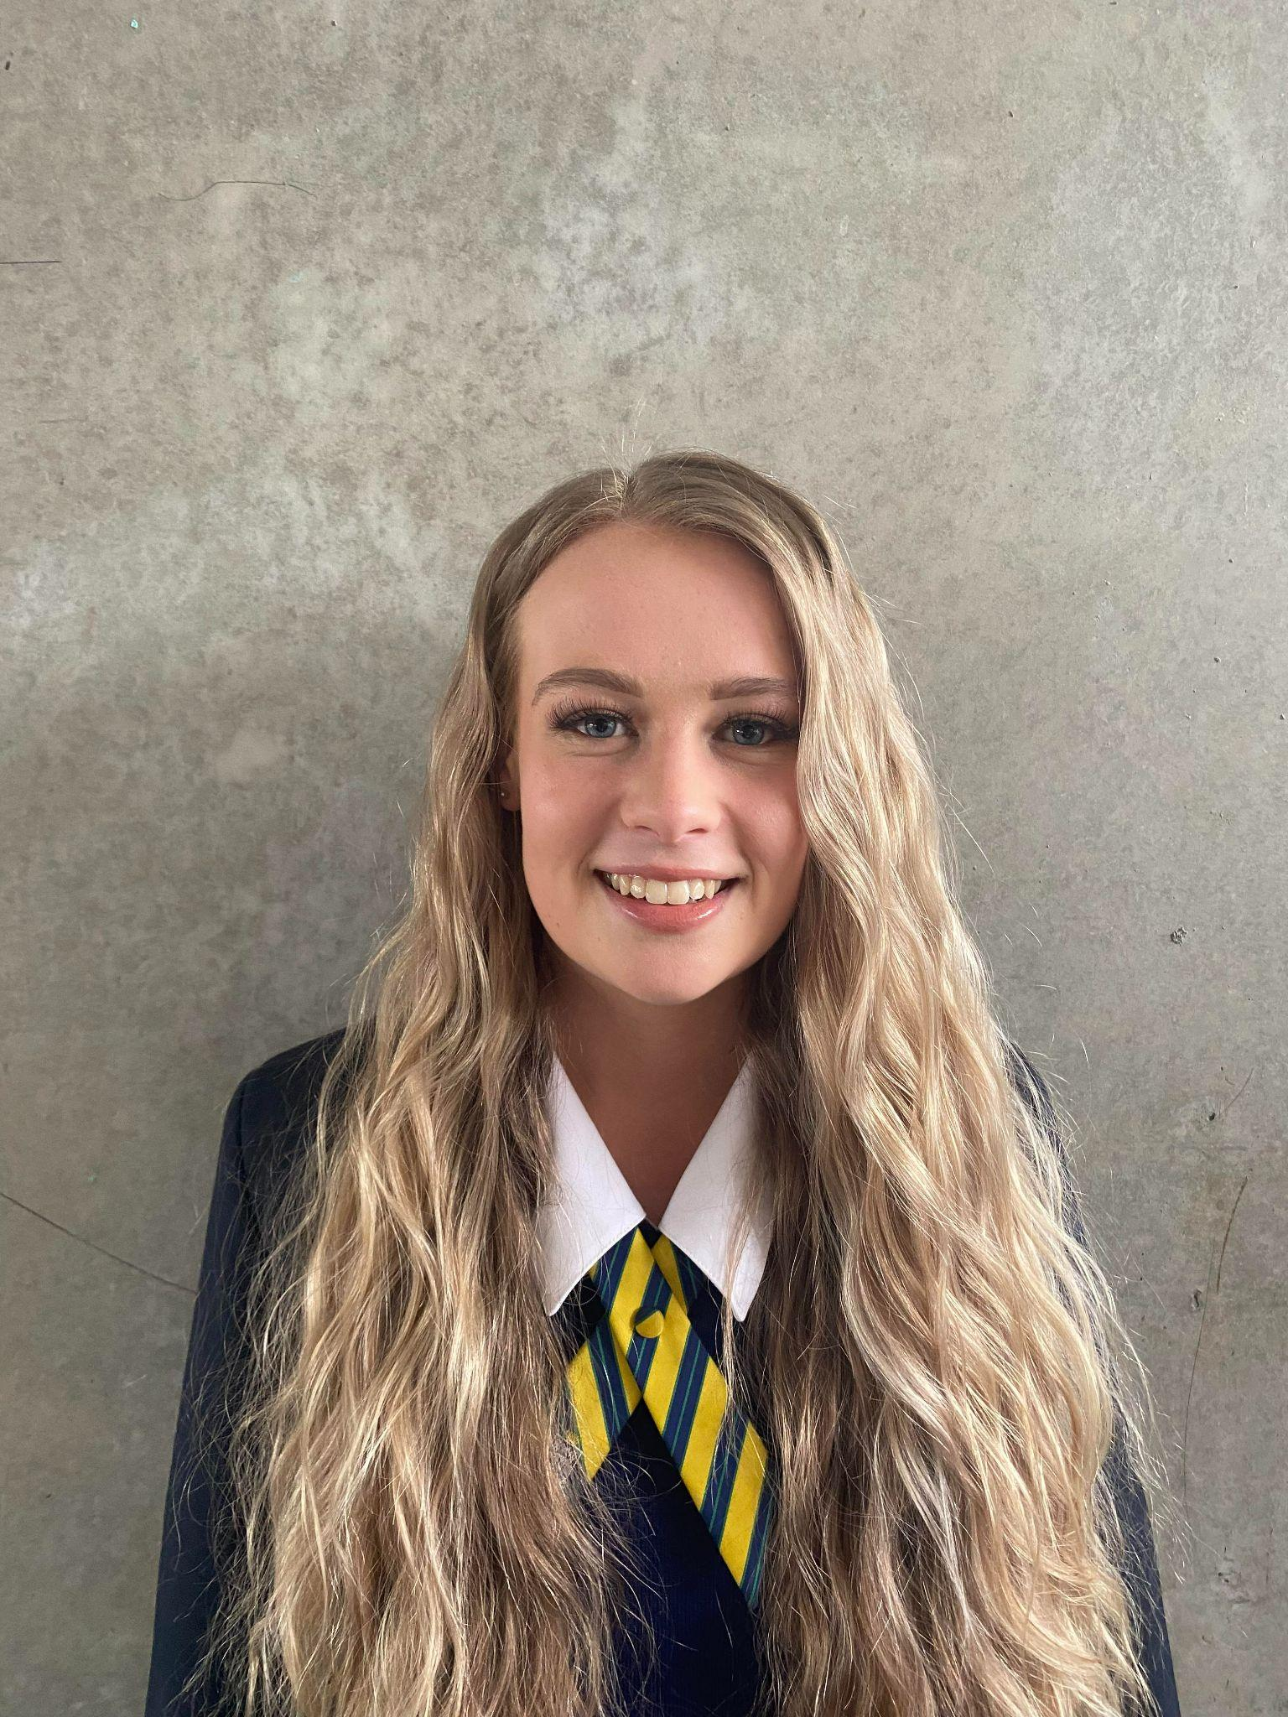
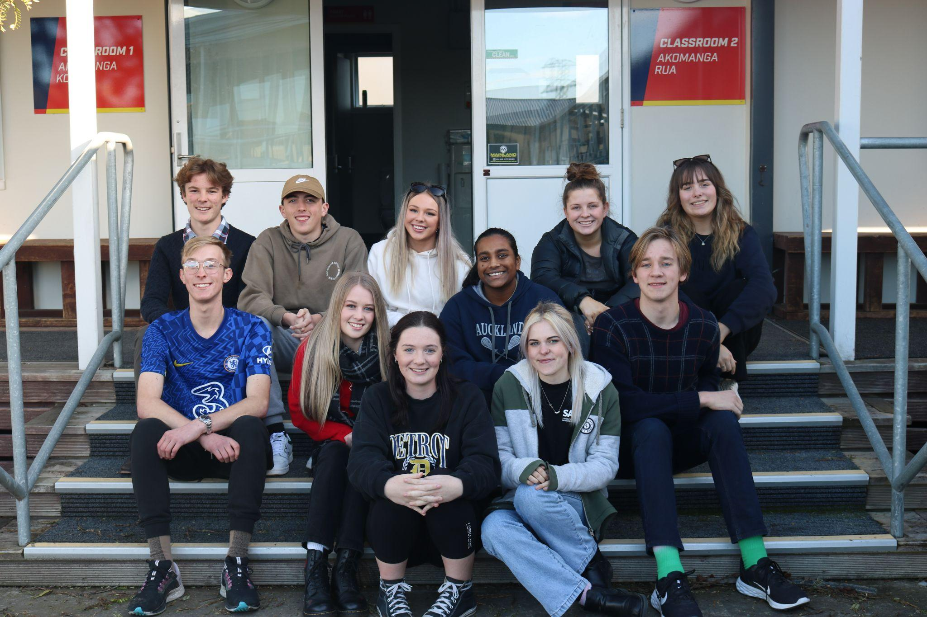
Introduction:
Hello, my name is Tayla Hill
Year 13 National Leader for Students Against Dangerous Driving

Slide 3
SADD’s Journey
1985
2014
2022
Students Against Drunk Driving started
Name change to Students Against Dangerous Driving.
Maori name - Kaitiaki o Ara

Slide 4
What is SADD?
A student lead organisation aiming to make a positive difference on NZ roads.

Slide 5
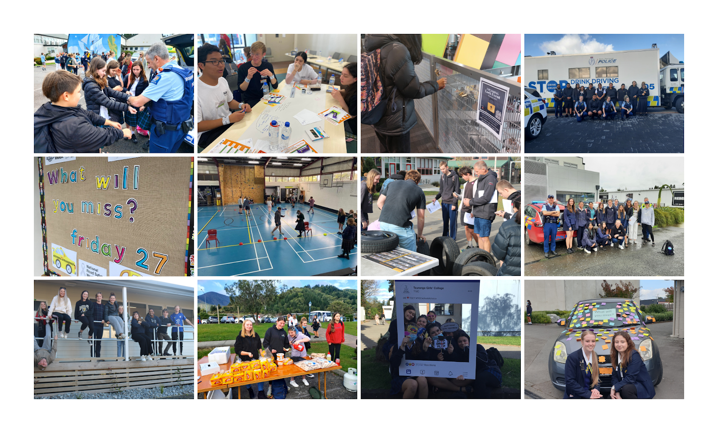
Outside organizations we work with:
Police
Fire and Emergency
Road Safety Coordinator
Other Community Groups

Slide 6
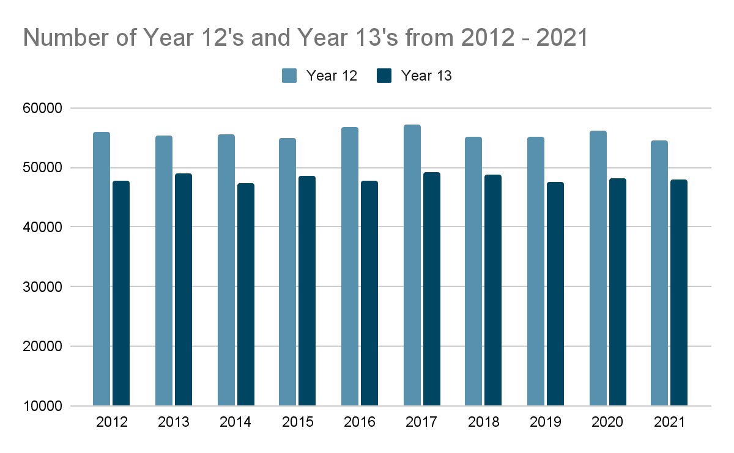
Amount of youth on our roads
217,054
277
43
In 2020:
young drivers (16-24), went for their license.
young drivers (16-24) were seriously injured
young drivers (16-24) died

Slide 7
Personal experience doing defensive driving course.
Conditions
Risks
Driving in different conditions affect our driving, this could be weather related or how we are feeling.
What are the risks we can identify on our roads?
Driver Safety
Connection
Understanding what we need to do to stay safe.
We’re all connected on our roads, whether we’re driving or a pedestrian.

Slide 8
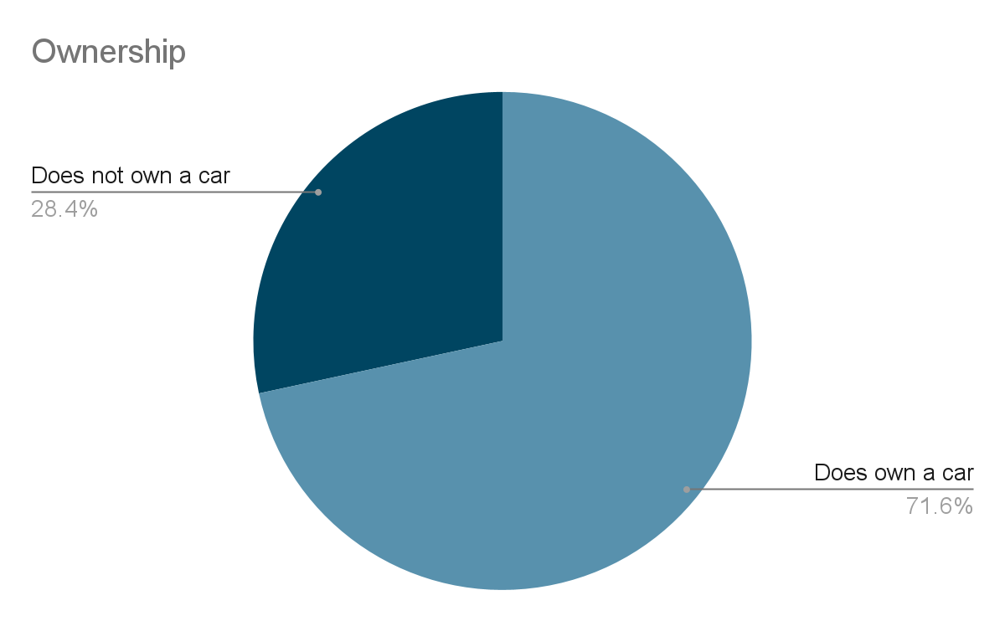
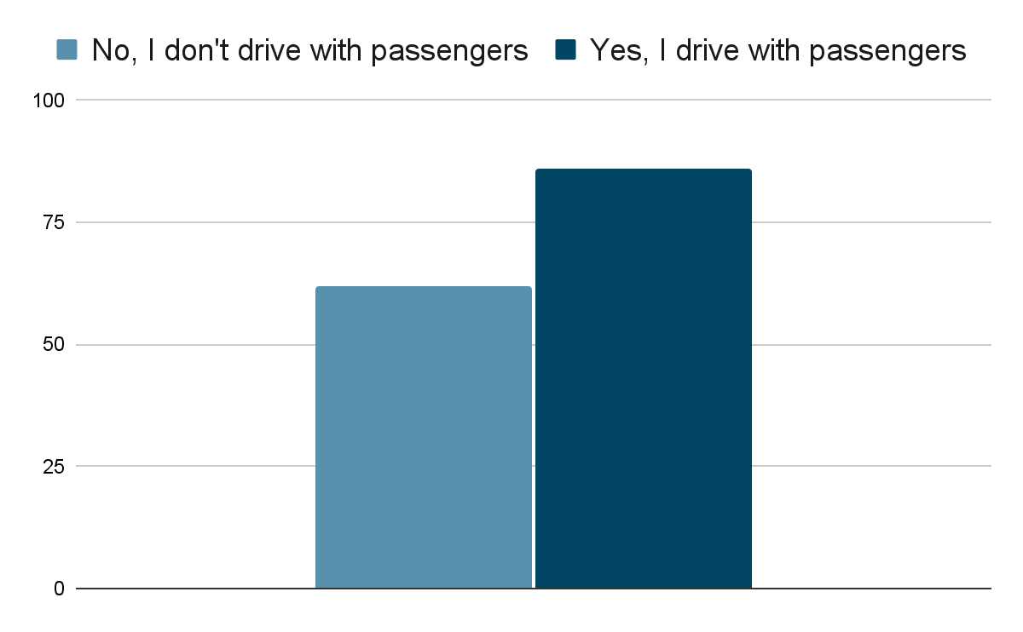
Results
They trust their child to be a safe driver | 9
If their child is caught, it is their issue to deal with | 11
It is more convenient for the parents if their child carries passengers, specifically siblings | 23
Parents are not happy with it; they won’t do anything to stop them | 21

Slide 10
Lack of knowledge around road safety
JOHN PATTERSON
Why should I drive safer?
HELENA JAMES
“It isn’t just about getting your licence its about learning to become safe drivers”
XX DRIVER LICENSE XX
XX DRIVER LICENSE XX

Slide 11
Thank You

